Slide 1
Pattern Recognition
Chapter1 Introduction

Slide 2
Acknowledgments
Thanks to Alexanda Wong!
Because most of the materials of this course are come from his course ppt.
Thanks to Liang Jin and Linyuan Zhou for some of the application materials.

Slide 3
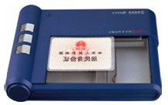
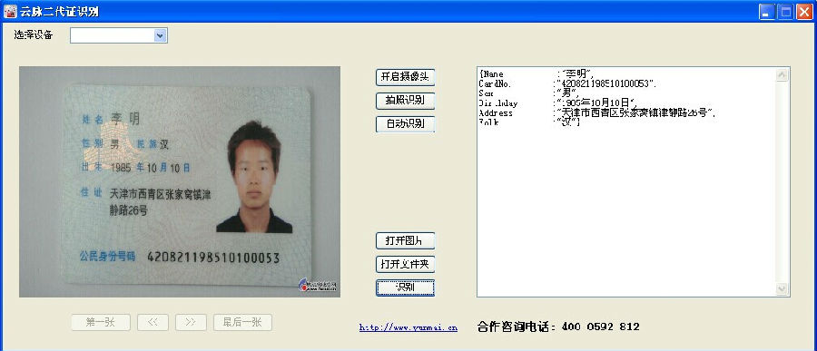
A case
ID information recognition
  区域定位（人像，姓名，号码等）；切分；汉字识别；数字识别
Notes:
有些场合，需要非接触式/非原始证件的ID信息提供（例如，淘宝平台上的身份证明），

Slide 4
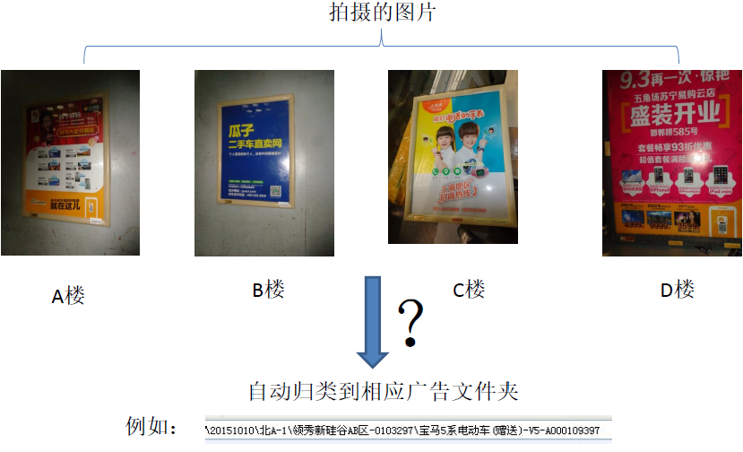
A case
A Case
What is Pattern Recognition?
General Framework of PR
Feature
Class
Classsification problem
Similarity
Relationship with Machine Learning
广告点位图像识别和校验
校验楼宇广告内容：需要自动图片（检查人员拍摄）归类，然后人工/自动校验是否发生了张贴内容错误！
校验是否有张贴内容错误！

Slide 5
A Case
A Case
What is Pattern Recognition?
General Framework of PR
Feature
Class
Classsification problem
Similarity
Relationship with Machine Learning
实现思路：
  （1）广告框上贴带有数字ID的标签
  （2）检查员拍摄张贴好的广告图片并上传。
  （3）程序自动检测并识别ID数字信息
  （4）程序根据ID将图片自动归类
  （5）由ID调出模版图像与张贴图像比对一致性
  （6）人工审核不一致的结果（判断是ID识别错误还是广告张贴错误）

Slide 6
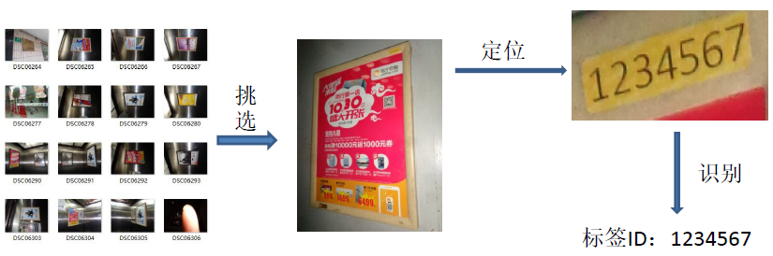
A Case: 难点
A Case
What is Pattern Recognition?
General Framework of PR
Feature
Class
Classsification problem
Similarity
Relationship with Machine Learning
从众多图片中挑选待识别的广告图像
拍摄照片的清晰度
图像中定位标签块
标签上的数字识别

Slide 7











Let’s do Digital Num. Recognition!
A Case
What is Pattern Recognition?
General Framework of PR
Feature
Class
Classsification problem
Similarity
Relationship with Machine Learning

Slide 8
Let’s do Digital Num. Recognition!
A Case
What is Pattern Recognition?
General Framework of PR
Feature
Class
Classsification problem
Similarity
Relationship with Machine Learning
数字图片样本库（92651个0；116463个1；83251个2；47334个3；35140个4；33620个5；26319个6；27199个7；30656个8；48790个9；2663个X）
目标：一个数字分类器 y=NumR(x)
  输入x：一个数字图片(假定只包含一个数字)
  输出y：图片上的数字识别结果
评价分类器的性能
Notes:
课堂问题（测试一下分析能力）：对ID数字样本库的数目分布给一个合理的解释！

Slide 9
What is Pattern Recognition?
A Case
What is Pattern Recognition?
General Framework of PR
Feature
Class
Classsification problem
Similarity
Relationship with Machine Learning
Pattern recognition (PR)
is the study or process of “machines observe the environment, learn to distinguish patterns of interest from their background, and make sound and reasonable decisions about the categories of the patterns”. (Anil K. Jain)

Slide 10
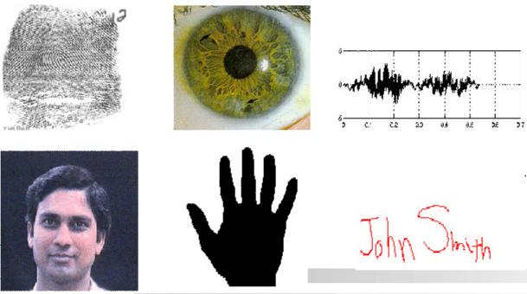
Pattern
A Case
What is Pattern Recognition?
General Framework of PR
Feature
Class
Classsification problem
Similarity
Relationship with Machine Learning
“ the opposite of a chaos; it is an entity, vaguely defined, that could be given a name” (Satoshi Watanable,1985)
Watanabe, S. (1985). Pattern recognition: human and mechanical. Wiley, 1985

Slide 11
General PR framework
A Case
What is Pattern Recognition?
General Framework of PR
Feature
Class
Classsification problem
Similarity
Relationship with Machine Learning
The general PR framework consists of the following components:
Measurement:
  The input pattern is measured (e.g., taking a picture).
Feature Extraction:
  Features are extracted to create the concise representation of the pattern
Classification
  Assign a class label to the pattern based on some model
Feature Selection
  Select a set of meaningful features to represent the samples used for training
Learning
  Learn a model based on the features representing the samples

Slide 12
General PR Framework
A Case
What is Pattern Recognition?
General Framework of PR
Feature
Class
Classsification problem
Similarity
Relationship with Machine Learning
→不涉及硬件系统时，可从这里开始研究（如，上面的ID数字识别）
Pattern
Measurement
Feature extraction
Classification
Recognition
Analysis/Training
Feature selection
Learning
Samples
(measurements+labels)

Slide 13
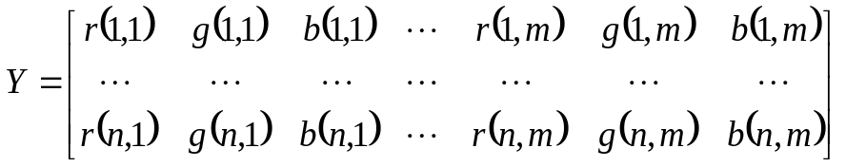
General PR Framework
A Case
What is Pattern Recognition?
General Framework of PR
Feature
Class
Classsification problem
Similarity
Relationship with Machine Learning
Measurements represented by a vector, Y, consisting of ny measurements obtained from sensor (e.g., color intensities at each pixels in image)
Features represented by a vector, X, consisting of nx features obtained from measurements (e.g., mean color, shape, size, texture, etc.)
Class label represented by a number L∈{0,1,…,C-1} ,C is the number of classes.
Classifier represented by a function Classifier()
L=Classifier(X) or L=Classifier(Y)
这样，一个实际PR问题就转换为我们容易处理的形式了。 从数学角度讲：给出一个最佳的函数 Classifer(); 从编程角度讲：编写一个程序 Classifier()
Notes:
这样的话，任意一个模式识别问题，都可以使用数学，或者编程来具体实现了。
举例说明:

Slide 14
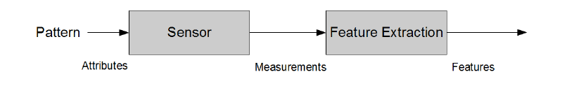
Patterns, measurements and features
A Case
What is Pattern Recognition?
General Framework of PR
Feature
Class
Classsification problem
Similarity
Relationship with Machine Learning
Patterns have properties or attributes which distinguishes it from other patterns (e.g., apples vs. oranges)
Measurements taken of a pattern should reflect either directly or indirectly the attributes associated with pattern (e.g., images that can see the patterns)
Features provide a concise representation of measurements to facilitate classification (e.g., shape, color, size, etc.)
Notes:
对于所处理Pattern, Sensor, featruer extraction 的一些基本要求！

Slide 15
Feature extraction and classification
A Case
What is Pattern Recognition?
General Framework of PR
Feature
Class
Classsification problem
Similarity
Relationship with Machine Learning
  Feature extraction: process of transforming from measurements to features. Attempts to recover defining attributes from patterns to facilitate classification
Classification: process of transforming features into class name or labels
Strong relationship between feature extraction and classification. For example:
  Good feature allow for simple classifiers(e.g., best feature is just the class label!)
  Complex classifiers compensate for features that are not linearly seperatable.
Feature extraction
Classification

Slide 16
Class
A Case
What is Pattern Recognition?
General Framework of PR
Feature
Class
Classsification problem
Similarity
Relationship with Machine Learning
Goal of pattern recognition is to assign input to a class
A class is a group or set of patterns which are similar in some sense(i.e., share some common properties or attributes)
Need to represent class somehow:
  Prototype: idealized form that boils down the “essence” of a class(e.g., mean apple) 比较相似性来判断最终类别归属
  Set of samples known to belong to a class (e.g., a bunch of samples known to be apples) 作为训练样本训练分类器，决定新样本的类别归属。

Slide 17
Class in feature space
A Case
What is Pattern Recognition?
General Framework of PR
Feature
Class
Classsification problem
Similarity
Relationship with Machine Learning
Note: patterns does not need to be identical to belong to the same class (e.g., not all apples have to be the exact same color)
Patterns within the same class may different due to:
  Noise or random variations in measurement process (e.g., apple imaged at different perspectives)
  Inherent variability within a class (e.g., some apples are longer or rounder than others)
A class typically spans a region within feature space to account for differences in measurement and feature values amongst its members.

Slide 18
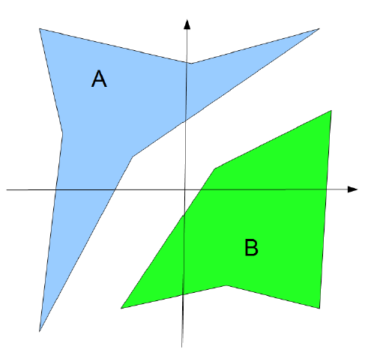
Class in feature space
A Case
What is Pattern Recognition?
General Framework of PR
Feature
Class
Classsification problem
Similarity
Relationship with Machine Learning
Notes:
比如说：A 红苹果，B 绿苹果， 横轴为绿色，纵轴红色

Slide 19
Classification problems
A Case
What is Pattern Recognition?
General Framework of PR
Feature
Class
Classsification problem
Similarity
Relationship with Machine Learning
Three conceptually different types of classification problems we wish to tackle:
1. Probability model is known for each class:
  Typical in cases where the physical process is known and provides a probability model ( e.g., Gaussian noise ) or reasonable assumption can be made about the probabilistic behavior (e.g., car arrival time as a Poisson process)
  Statistical decision theory may be used to find optimal classification in the sense of minimizing probability of error.
Notes:
举例：高斯噪声源分类
已知：
“源1”产生 均值为0,方差为5 的高斯噪声
“源2”产生 均值为5,方差为5 的高斯噪声
求一最佳分类器判断新来噪声x,到底来自哪一个噪声源？

Slide 20
Classification problems
A Case
What is Pattern Recognition?
General Framework of PR
Feature
Class
Classsification problem
Similarity
Relationship with Machine Learning
Three conceptually different types of classification problems we wish to tackle:
2. Samples with known class labels:
  Typical in cases where we wish to use samples that have been manually labeled for classification (e.g., face images tagged by human observer)
  Tow possible approaches: i) learn empirical probability model based on samples, and ii) derive classifiers directly from distribution of samples in feature space.

Slide 21
Classification problems
A Case
What is Pattern Recognition?
General Framework of PR
Feature
Class
Classsification problem
Similarity
Relationship with Machine Learning
Three conceptually different types of classification problems we wish to tackle:
3. Samples with no other known label information:
  Need to not only determine the definition of each class, but also determine the number of classes!
  Commonly referred to as clustering problem
  Approach is to look for naturally occurring order, grouping s or clusters in the data.

Slide 22
Similarity
A Case
What is Pattern Recognition?
General Framework of PR
Feature
Class
Classsification problem
Similarity
Relationship with Machine Learning
Regardless of initial class definition, pattern recognition system must assign unknown pattern to known class.
To make decision, classifier needs to assess similarity of unknown pattern to known class
Two patterns are similar if they share common properties.
In vector space representation, sharing common properties implies closeness in feature space
Such closeness can be measured quantitatively using a distance metric d(y1,y2). (The lower the d, the greater the similarity)

Slide 23
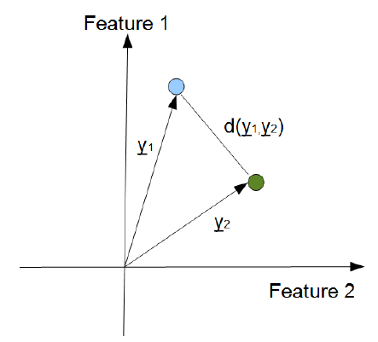
Similarity
A Case
What is Pattern Recognition?
General Framework of PR
Feature
Class
Classsification problem
Similarity
Relationship with Machine Learning

Slide 24
Challenges with designing similarity measures
A Case
What is Pattern Recognition?
General Framework of PR
Feature
Class
Classsification problem
Similarity
Relationship with Machine Learning
Features may have fundamentally different natures that are hard to compare as a whole (or even hard to quantify)
  Some features are continues(height) and some are discrete (number of children)
  Some features are unordered states (sex, race religious denomination, etc.)
What similarity measure is appropriate for classifying based on such features?

Slide 25
Relationship with Machine Learning
A Case
What is Pattern Recognition?
General Framework of PR
Feature
Class
Classsification problem
Similarity
Relationship with Machine Learning
Pattern
Measurement
Feature extraction
Classification
Recognition
Analysis/Training
Feature selection
Learning
Samples
(measurements+labels)
“Machine learning is a subfield of computer science that evolved from the study of pattern recognition and computational learning theory in artificial intelligence.” –Wikipedia
Supervised classification → supervised learning
Unsupervised classification → unsupervised learning
Semisupervised classification→ semisupervised learning

Slide 26
Content of this curse
Introduction
基于距离的分类
基于统计决策的分类
基于判别分析的分类
非监督分类
性能评价
特征选择与提取
PCA
LDA
逻辑回归

